Slide 1

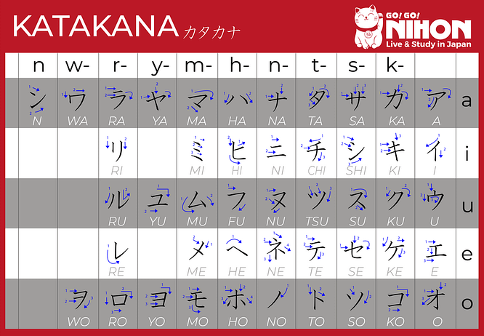
Menu
評価部品最大応力一覧
Đánh lạc hướng 1
STT | Name | [MPa]
1 | Part 1半 | 12.4
2 | Part 2 (chi tiết) | 34.5
3 | Assem半濁点 | 25.7
4 | Assem送り仮 | 25.7
5 | Part 5 (chi tiết) | 66.7
6 | Part 6 | 78.9
7 | Assem_seven(Top) | 45.7
8 | Assem_seven(Bottom) | 56.4
8 | Part-Nine | 1234
Part 1半
Part 2
Assem半濁点
Assem送り仮名
Đánh lạc hướng 2
Đánh lạc hướng 3
Assem_seven
Part 5
Part-Nine
Part 6

Slide 2
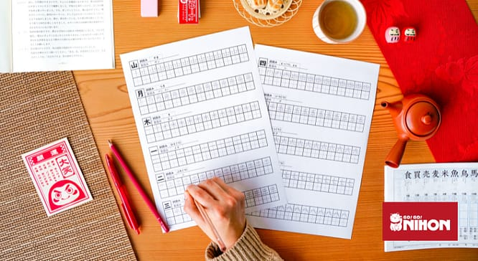
Part 1半
Title1
#1: 12.4[MPa]
Part 1半
Part 2
Part 2半
#2: 34.5[MPa]

Slide 3
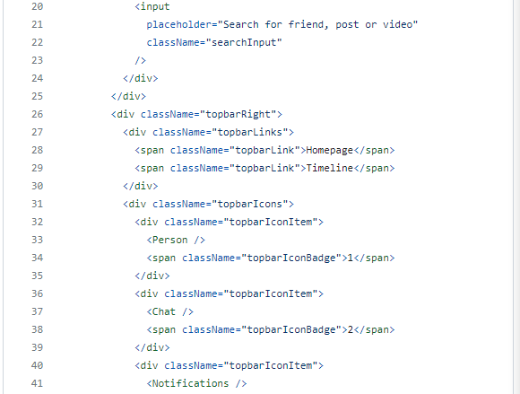
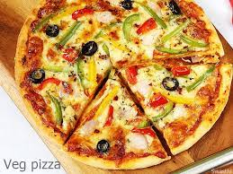

Assem半濁点
Title2
#3: 25.7 [MPa]
TableWrong2
Wrong1 | WrongCol1
wrong2 | WrongCol2
wrong3 | WrongCol3
Assem半濁点
Assem送り仮名
Assem送り仮名
TableWrong
Wrong1 | WrongCol1
wrong2 | WrongCol2
#4: 25.7 [MPa]

Slide 4

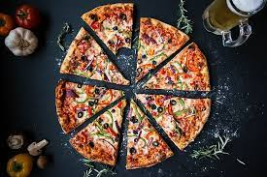
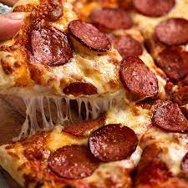
Assem_seven
Title2
#7: 45.7 [MPa]
Assem_seven
Part-Eight
Part-Eight
TableWrong2
Wrong1 | WrongCol1
wrong2 | WrongCol2
wrong3 | WrongCol3
#7: 56.9 [MPa]

